Slide 1
MSc Project Recommender Systems: looking further into the future
Meeting: 13/06/2023

Slide 2
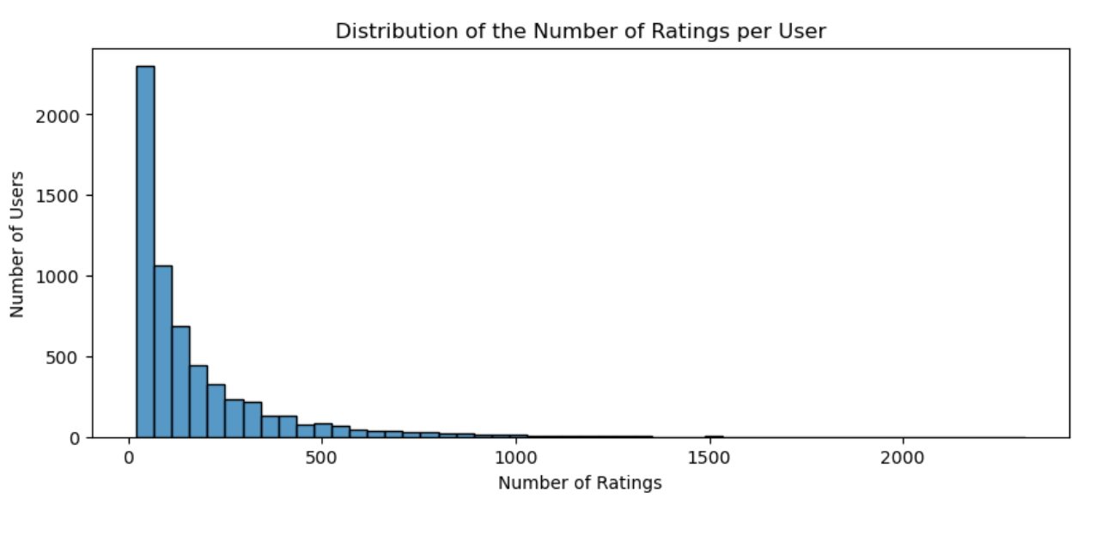
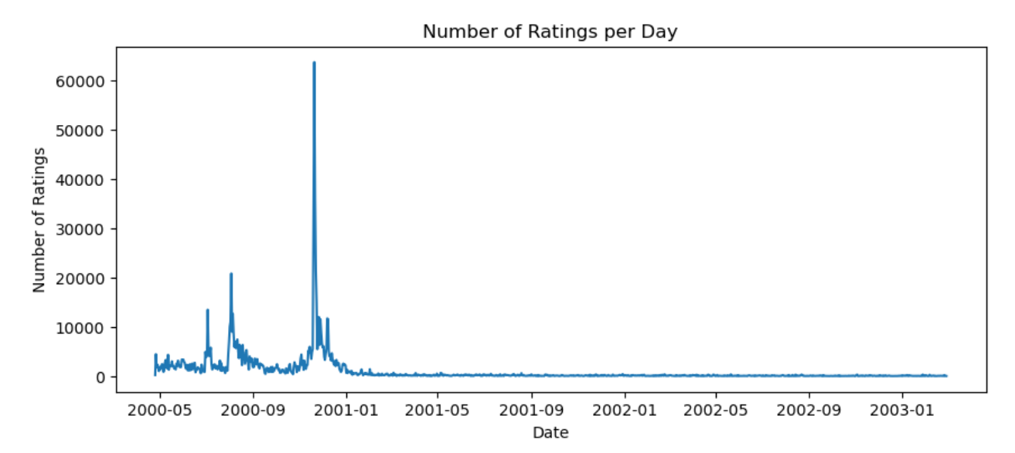
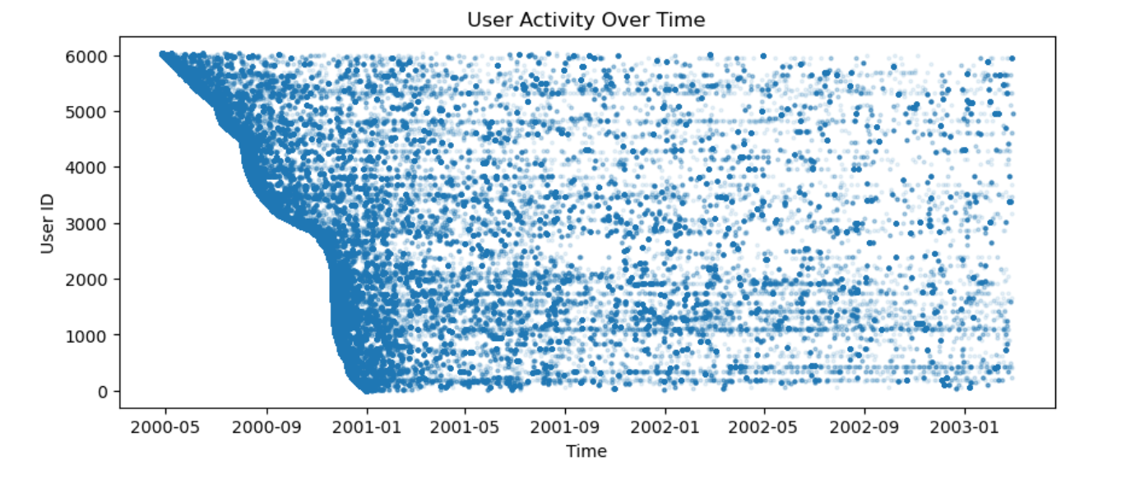
EDA on ML-1M:
Num. of users – items – avg. action/user – tot. num. actions:
6040 - 3706 - 165.57 - 1000209
Avg. sequence length in days for each user: 95.0069
Average number of 7-day windows per user: approximately 14.4
Minimum number of 7-day windows per user: 1
Maximum number of 7-day windows per user: 148
Number of users with only one 7-day window: 4243. 2/3 of data.
Users not active → Time window predictor will be difficult.

Slide 3
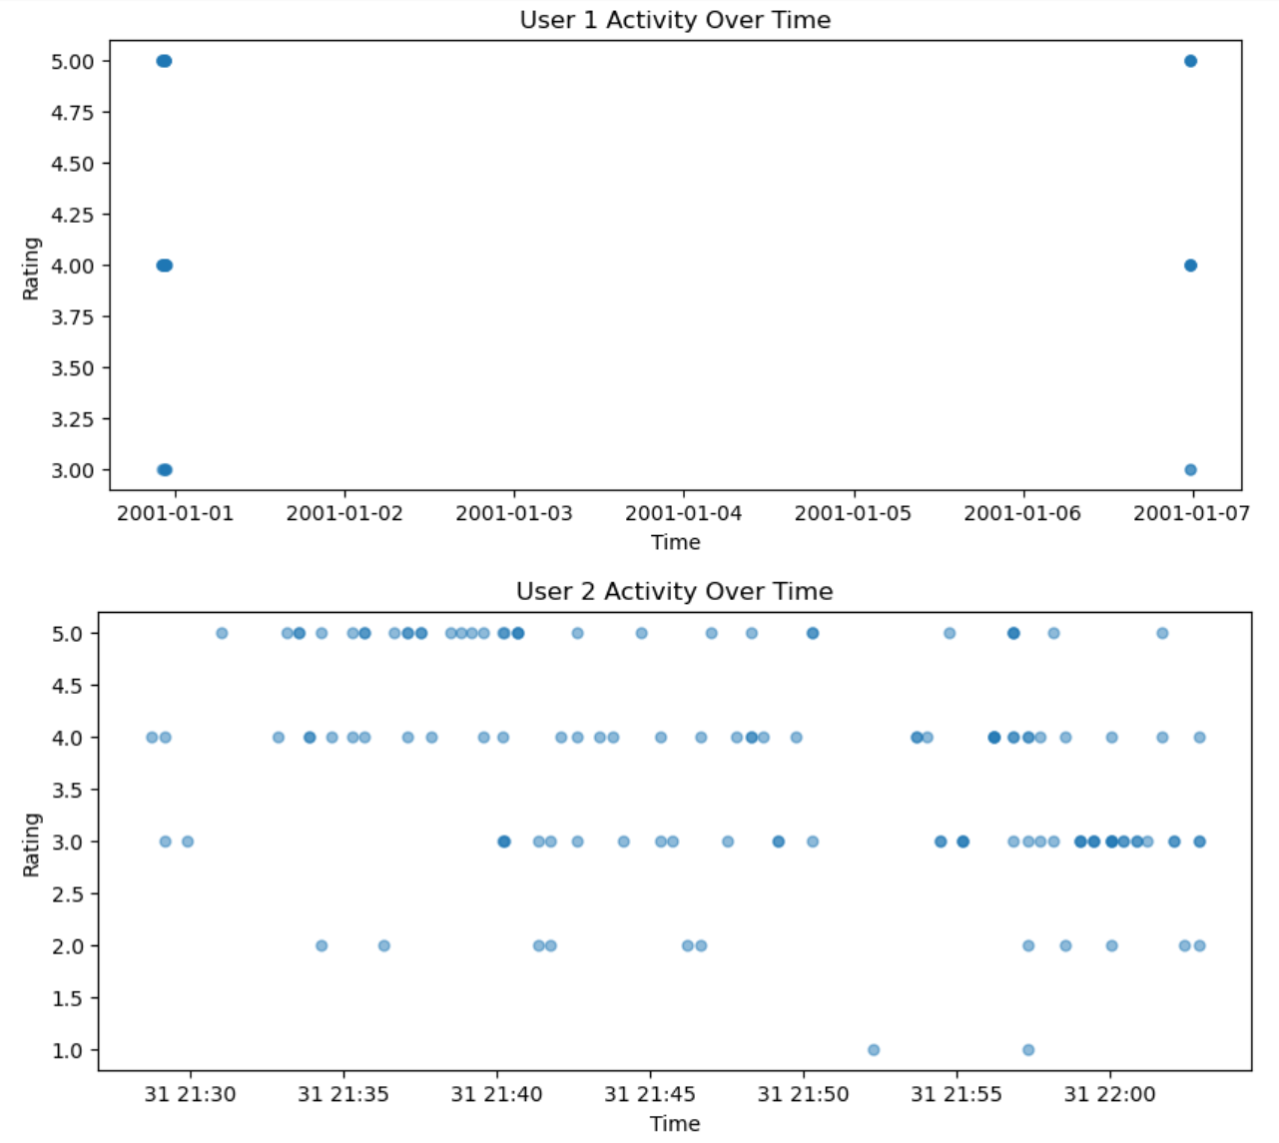
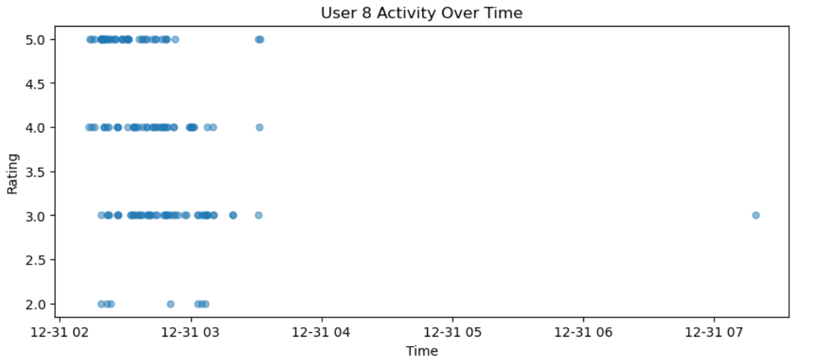
EDA on ML-1M:

Slide 4
Baselines:
TiSASRec - Replicate:
test (NDCG@10: 0.5727, HR@10: 0.8010) – as expected
SASRec Window Evaluation:
Instead of having only one item in valid and test → create lists of k-items ordered in the future according to interaction (not time).
E.g. test[user] = [item5, item3, item8, item1, item7, item2, item4] – ordered interactions of the user.
For each k position into the future:
Samples 99 random items plus 1 pos (e.g. item5) and get predictions
If model ranks item5 in top 10 of these predictions → increase metrices
Evaluation of item in the k-future, independent of the previous items in test. Each interaction evaluated in isolation (computational more efficient than sequential evaluation?). Returns a list with metrices for each position.
Evaluation done only if user has k future interactions in test otherwise skip.

Slide 5
Baselines:
SASRec Window Evaluation Experiment:
Position Test_NDCG Test_HR
1 0.6336 0.9110
2 0.5957 0.8782
3 0.5738 0.8584
4 0.5458 0.8343
5 0.5209 0.8113
6 0.4977 0.7976
7 0.4744 0.7737
Evaluates on 4605 users → skipped the rest
Leakage problem (obviously ☹ - need to change splitting as well).
Evaluating further into the future drops perf. → makes sense.

Slide 6
Baselines:
SASRec – Window sequences handling in training :
Split train / valid / test as 80%/10%/10% of the whole sequence to create window representations – Ordered preservation.
E.g. seq. [1, 2, 3, 4, 5, 6, 7, 8, 9, 10]
→ valid will be [7,8]
→ test will be [9, 10]
Then instead of having one target for the training sequence, create a window target sequence e.g. [5,6]. Rest is the input seq. of training.
New input target pairs will be:
→ [1, 2, 3, 4, 5]
→ [1, 2, 3, 4, 6]
E.g. input sequence predicts next-item 1, the second sequence predicts next-purchase 2 and so on. Trained to predict next interactions based on the previous interactions.

Slide 7
Baselines:
SASRec Window Evaluation & Window Seq. Handling Experiment:
Position Test_NDCG Test_HT
1 0.5576 0.8326 # ndcg down ht slightly up
2 0.5418 0.8156
3 0.5160 0.8004
4 0.4925 0.7813
5 0.4723 0.7587
6 0.4607 0.7494
7 0.4432 0.7327
Evaluates on 4605 users → skipped the rest
No Leakage problem (☺ - I think – need to make sure).
Evaluating further into the future drops → makes sense.

Slide 8
Future:
Investigate more problems with evaluation.
Start thinking about temporal information.
EDA on Steam dataset
Teacher-forcing approach?
[1,2,3,4,5] target is 5
Then [1,2,3,4,5(ground truth),6] target is 6
Autoregressive approach?
[1,2,3,4,5] target is 5
[1,2,3,4,5(predicted), 6] target is 6
Think about loss change to make multiple target predictions.

